Slide 1
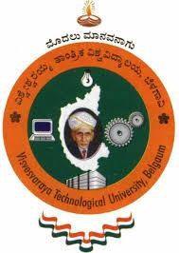

VISVESVARAYA TECHNOLOGICAL UNIVERSITY
“Jnana Sangama”, Belagavi, Karnataka - 590018
VI SEM : MINI – PROJECT ( 18EEMP68 )
Gesture Controlled Robot Using IOT
Under the Guidance of
Name : Mr Balaji Chakravarthy Designation : Assistant Professor
Gaurav Jagadeesh ( 1RN19EE014 )
Nischitha T (1RN19EE031)
Sakshi R(1RN19EE038 )
V Pallavi ( 1RN19EE043)
DEPARTMENT OF ELECTRICAL AND ELECTRONICS ENGINEERING
RNS INSTITUTE OF TECHNOLOGY
Channasandra, Dr. Vishnuvardhan Road, Bengaluru – 560 098

Slide 2
CONTENTS
Introduction
Abstract
Circuit diagram
Working
Components
Hardware descriptions
Approximate cost of the project
Applications
References

Slide 3
ABSTRACT
During the pandemic the was a lot of importance of contactless services.
Conventionally machines are controlled by using joysticks, remote controllers, mobile applications.
In this study we propose the use of hand gestures as a method to control a simple machine. Gesture control is the ability to recognize and interpret movements of the human body in order to interact with and control a computer system without direct physical contact.
We investigate the use of computer vision methods to develop an intuitive way of communication between other devices and its operator.
This is done by using internet of things.

Slide 4
INTRODUCTION
All robots operate on inputs given by a user. These inputs can be conveying the basic rudimentary signals such as high or low voltages.
Combination of these signals can be used to define a certain actions in a complex robot.
These signals can be sent to the robot through cables, Bluetooth or Wi-Fi.
But human ingenuity precedes to make things more accessible than ever.
During the pandemic, the idea of contactless equipment and devices flourished and brought forth a major deal of development in recognition software.
Gesture control is the ability to recognize and interpret movements of the human body in order to interact with and control a computer system without direct physical contact.

Slide 5
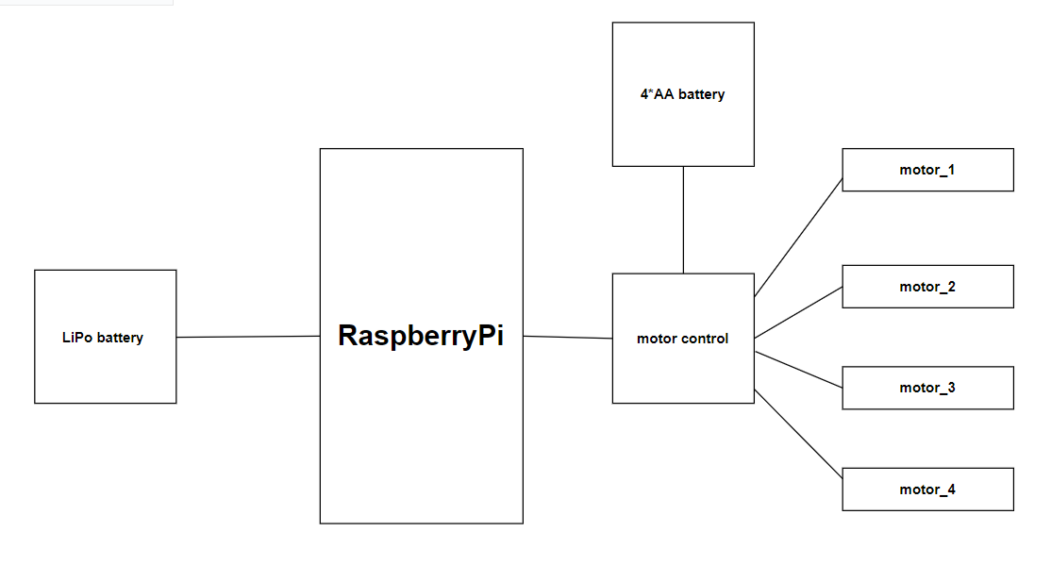
BLOCK DIAGRAM

Slide 6
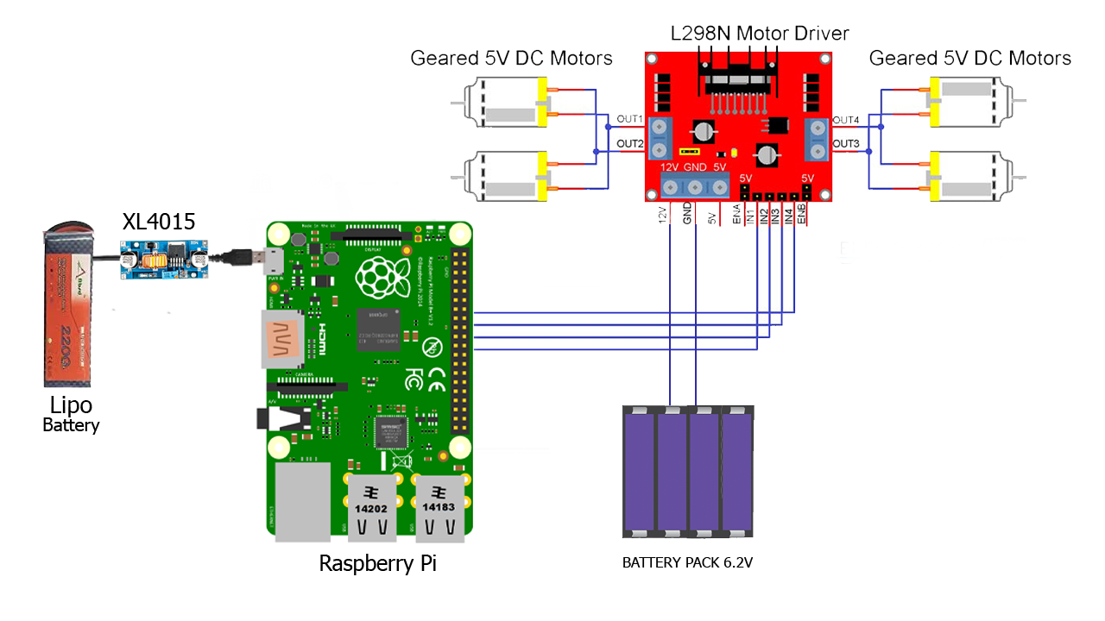
CIRCUIT DIAGRAM

Slide 7
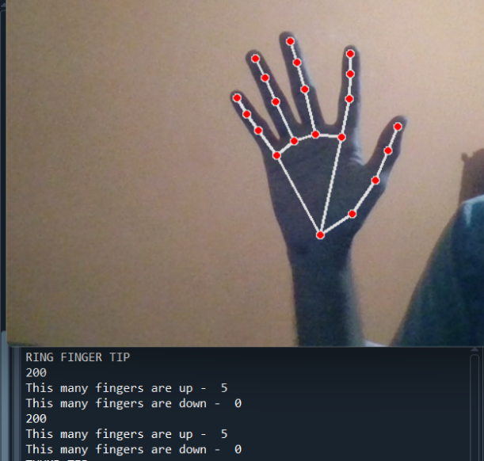
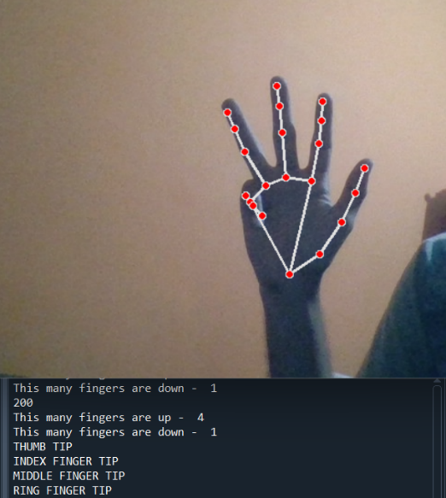
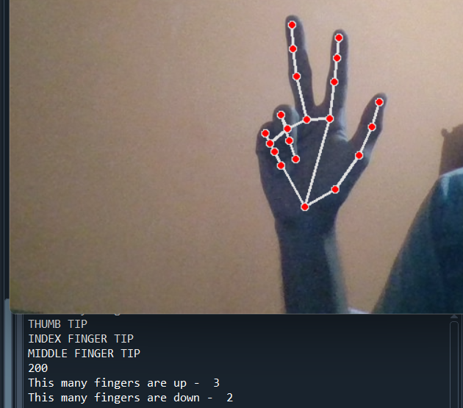
WORKING
Gesture recognition and Input
The principal concept being gesture recognitions. The robot doesn’t move or undergo any motion until the terminal conditions are satisfied.
Using an open-source machine learnt module called MediaPipe, we detect and track the position of each tip of the finger that is in the live video feed.
Based on the position of the tip of each finger with respect to its own knuckle. We are able to identify if the finger is open or close. By this base logic, we can count the total fingers that are open.
The number of fingers up are uploaded onto the cloud.

Slide 8
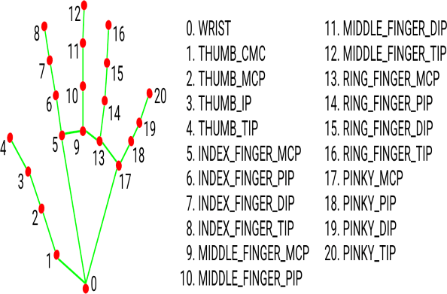
TRACKING
Creating a hand tracking program
MediaPipe is used to perform handtracking
Palm Detection- MediaPipe works on the complete input image and provides a complete input
image and provides a cropped image of the hand.
Hand Landmarks Identification-MediaPipe finds 21 hand landmarks on the cropped image of the hand.

Slide 9
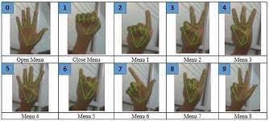
CONTROLS
◆ Gesture control system uses sensors to read and interpret hand movements as commands. A gesture recognition system starts with a camera pointed at a specific three-dimensional zone within the drone, capturing frame-by-frame images of hand positions and motions.
◆ Those images are analyzed in real time by computer vision and machine learning technologies, which translate the hand motions into commands, based on a predetermined library of signs.
◆ Commands generated by the gesture recognition software become just another type of input.

Slide 10
Robot controls
The code in the Rpi always keeps checking for the value that is uploaded to the cloud.
The following commands show the control of the robot.
Once any one of the condition is satisfied, the Rpi send a signal to the L298N, that controls 4 dc motors that make the robot move according to the input.
Number of fingers open | Actions done by the drone
One | Moves forward
two | Moves backward
three | Turns right
four | Turns left
five | Stops executing the code

Slide 11
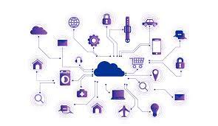

Usage of Internet of things
For communicating the gesture input to the robot, we have implemented the use cloud data transfer.
We have achieved this by using Blynk application
This allows us to build interfaces for controlling and monitoring the hardware components over the internet
We are using this platform to upload the number of fingers open onto the cloud from the laptop.
The value is constantly being uploaded on to the server.
The Rpi from takes the value from the interface executes commands as defined

Slide 12
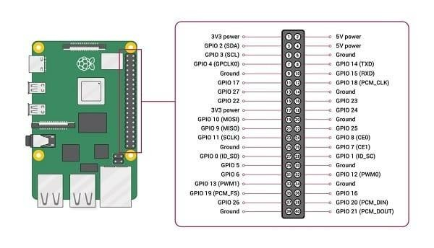
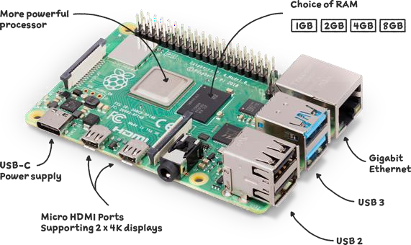
Rasberry Pi :
It is a mini computer which comes at an affordable price.
It has BCM 2835 system on chip with 1GB RAM. It has 40 pin GPIO connector and a single
core CPU operating at a speed of 1GHz.
Secure Digital (SD) cards in MicroSDHC form factor are used to store the operating system and program memory .Rasberry pi 3 can make use of USB attached SSD storage for its operating system. It has full gigabit ethernet .

Slide 13
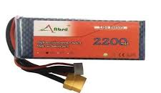
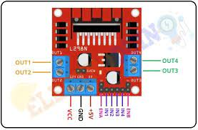
LiPo Battery :
LiPo batteries are differentiated 65 by the Capacity, C Rating, and the Cell Count. The capacity of the battery is measured in mili-amper hours (mah).
We will find 3S or 4S, aka 3 cells or 4 cells, where each cell has a nominal voltage of 3.7V. The entire setup is powered by a 11.1 volts 1300mAH 3 cell Lithium polymer (LiPo) battery.
Each cell can charge upto 4.2V. They are lighter in weight and smaller in size compared to the
other batteries.
L298N motor controller
It is a dual H-bridge motor driver which allows the
control of two or up to for dc motors.
It has an operating voltage between 5v to 12v.

Slide 14
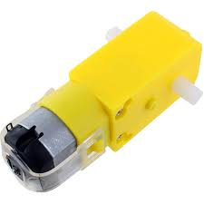
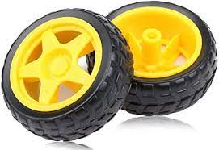
300 RPM BO Motor
Operating Voltage(VDC): 3~12
Shaft Diameter (mm): 5.5
Rated Speed: 300 RPM
65mm Robot Wheel for BO Motors
Wheel Width (mm) : 27
Body Material : Plastic
Grip Material : Rubber

Slide 15
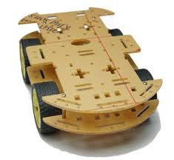
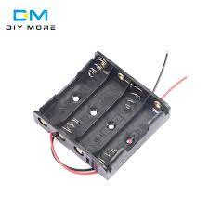
Battery pack
Car frame
Made of plastic
Dual frame
Used to arrange 4 AA batteries in series.

Slide 16
COMPONENTS AND COSTS
S.no | Name of components | Quantities | Cost
1. | RaspberryPi | 1 | Rs.2450
2. | LiPo battery | 1 | Rs.1100
3. | Car frame | 1 | Rs.100
4. | BO dc-motor | 4 | Rs.200
5. | L298N motor driver | 1 | Rs.150
6. | BO wheels | 4 | Rs.100
7. | AA batteries | 4 | Rs.100
8. | XL4051 | 1 | Rs.100

Slide 17
APPLICATIONS
Astronomical exploration vehicles
Surveillance.
Routine checkups
parking purposes
In medical field

Slide 18
ADVANTAGES OF GESTURE BASED CONTROLS
Using this method, the user can have contact less input source.
Is more intuitive.
Sequence of steps can be embedded within the system to be performed autonomously without supervision.

Slide 19
REFERENCES
Hand tracking source code :
https://github.com/T-Sumida/mediapipe_python4windows/blob/main/models/hand_tracker.py
Installation of python libraries:
https://www.youngwonks.com/blog/Remote-Controlled-Robot-Car-using-Raspberry-Pi
Application of Blynk:
https://www.jemrf.com/pages/interfacing-with-blynk
Building of car:
https://www.youngwonks.com/blog/Remote-Controlled-Robot-Car-using-Raspberry-Pi

Slide 20
THANK YOU

